Slide 1
History Of Diversity-based Legislation
Name
Institution of Affiliation
Professor
Date

Slide 2
Introduction
Diversity based legislation has been improving with time in the United States
A lot has been done to try and achieve legislation diversity in all the states making up the united states.
The legislation involves both citizens and the non-citizens working and residing in the US.
In the past, laws and legislations were made mainly in favor of the whites and this promoted discrimination and racism.

Slide 3
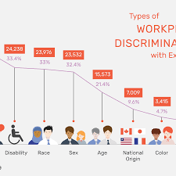

Slide 4
History of Diversity-based Legislation
This started after the first world war, where the minority groups started agitating for equality especially among the workers.
A diverse group of employees include a proportionate number of male and female and also balanced races and religions making that particular community.
This makes all the people feel part of the organization

Slide 5
In 18th century to around 1930s, workplace was basically dominated by men
In 1870, women made up 2.5% of the clerks in companies in the USA.
This number however rose to more than 50% by 1930.
In the same period, minority groups in the US were segregated and would not work in the service industry.
During the 1st world war, women gained skills as men had gone to war and this opened opportunities for them after the war.

Slide 6
The flapper era of 1920s created possibilities as women were seen as strong and capable.
The Women's Bureau of the Department of Labor was formed in 1920 to protect women at workplace and promote gender equality in regards to job opportunities.
The National Council of Negro Women was founded in 1935 to lobby Congress against racism, sexism and job discrimination.

Slide 7
After the 2rd world war, women returned in great numbers and occupied jobs opportunities left by servicemen.
They would work in the management positions in industries and even flew aircraft.
Despite women losing jobs, they would now with their lobby groups demand more job opportunities in the corporate world in the US.
President Harry Truman integrated the U.S. military in 1948 which led to mass change in the workplace.

Slide 8
President John Kennedy in 1961 established the Commission on the Status of women to improve hiring practices and maternity leave for all women workers.
The Equal Pay Act passed in 1963 which made it illegal to pay women wages less than men by all workers.
The 1964 Civil Rights Act was signed by President Lyndon Johnson abolishing any form of discrimination at workplace based on race and color.
Affirmative-action legislation was designed to level the employment opportunities for all races in the US.

Slide 9
Impact of Diversity Legislation
It guarantees equal employment for both genders
All races get employment opportunities unlike before.
People with disabilities also get employment opportunities to showcase their abilities and what they can do in the corporate world.
Women get management positions equally like their men counterparts with same qualifications.
Everyone have opportunity to get employed despite their age as long as they can offer the service satisfactorily.

Slide 10
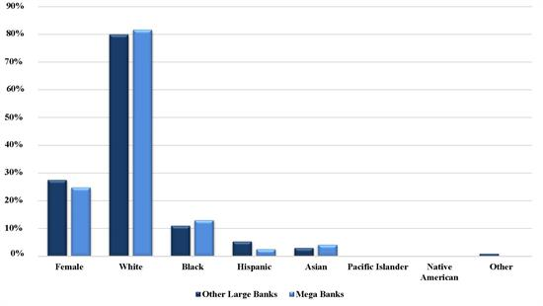

Slide 11
Challenges Of Legislating Diversity
Opposition from the majority groups like the whites opposing racial equality for the minority groups in US.
Some companies still do not recognize and give women leadership positions despite the affirmative Action legislation.
Companies still employing and preferring employing based on their color.

Slide 12
Lack of equal employment opportunities for people with disabilities despite the Americans with Disabilities Act (ADA) cover hence disability discrimination.
Organizations being adamant in employing people above the age of 40 years despite Age Discrimination in Employment Act (ADEA).
The argument is that they are not as productive and innovative like those below that age.

Slide 13
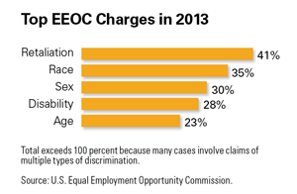

Slide 14
Compare Historical Legislation Of Diverse Populations To More Recent Diversity Legislation
The Civil Rights Act that included Title VII created freedom and rights for all the races especially blacks and whites.
It was meant to deal with racial discrimination especially on job and employment opportunities which had not succeeded in other legislations.
Title VII banned all kinds of discrimination of employees by private companies.

Slide 15
The basic tenants of affirmative action were upheld in 2003 by the U.S. Supreme Court in a University of Michigan case in which the justices ruled there is a "compelling" reason to maintain diversity in society.
Census figures show that women made up nearly 47 percent of the civilian workforce in 2013—compared with about 29 percent in 1967, when Title VII was still new (Beachum, 2020).

Slide 16
References
Beachum, F. (2020). Diversity and Multiculturalism. In Oxford Research Encyclopedia of Education.
https://bizfluent.com/about-5463620-history-diversity-workplace.html
https://opentextbc.ca/principlesofmanagementopenstax/chapter/challenges-of-diversity/

